Slide 1
Recent advances and learnings on optimizing the 2-sided marketplace on Upwork
2025 KDD TSMO Workshop
Frank Yang
VP Machine Learning
frankyang@upwork.com
Notes:
So excited to see many old and new friends here! Glad to see many ppls getting up so early to start working, this is a good segway to talk about “UpWork” now. The main purpose of this talk is to share some learnings that we have gained over the last a couple of years on building Upwork S&R models especially on the journey of building a discriminative deep learning and generative models.

Slide 2
Outline
Background
Multi-tasking deep learning and Multiple objective Optimization
DPO-based Search & Recommendation model
Future Work
Notes:
How many ppl know Upwork?

Slide 3
Upwork Business Model
~18M Freelancers
over 180 countries
$4B total GSV
in 2024 across ~10K skills
$39 hourly rate
on average
Create economic opportunities for clients and freelancers
Outcome-based delivery - hiring and delivering outcomes
Human + AI work model
Source

Slide 4
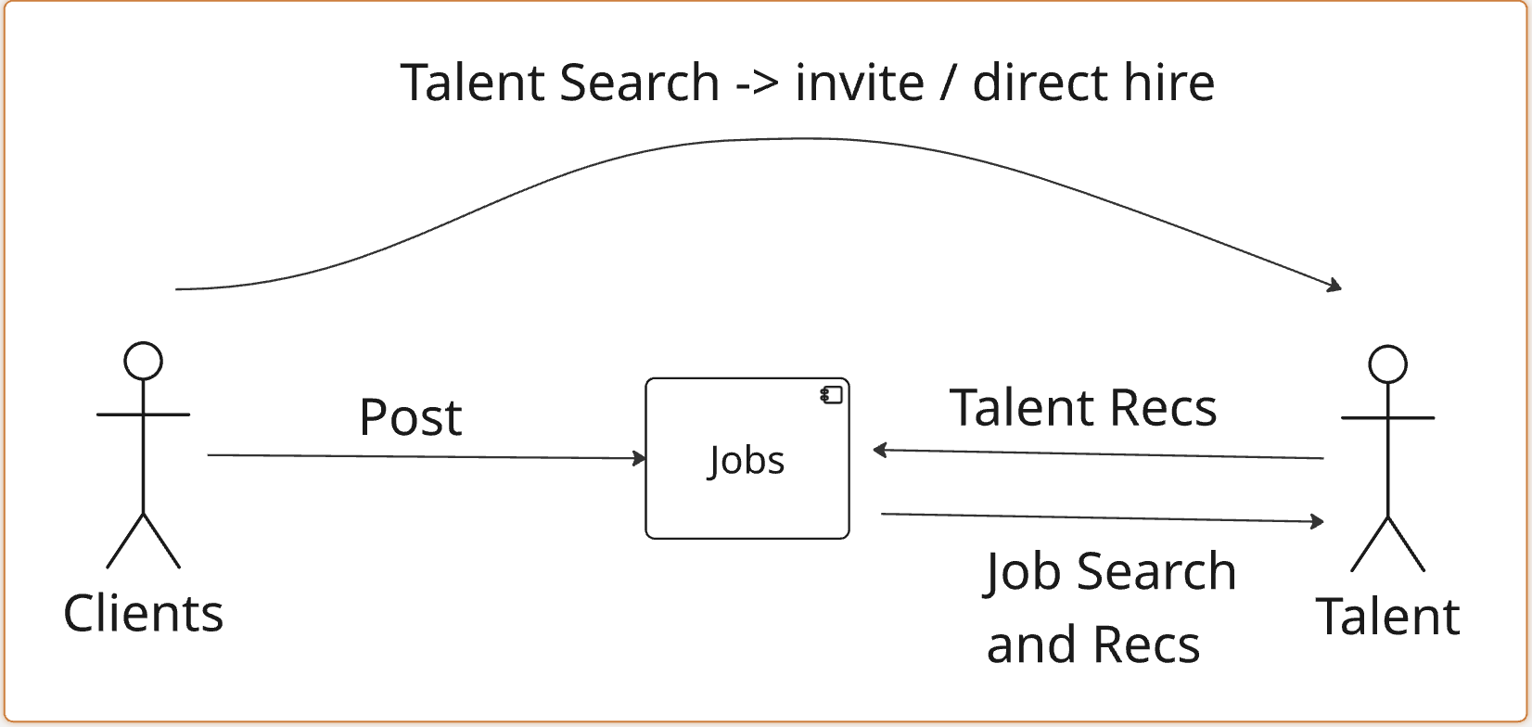
Upwork Hiring Flow is a 2-way Traffic
Notes:
25% direct hires
50% organic bids
25% invites

Slide 5
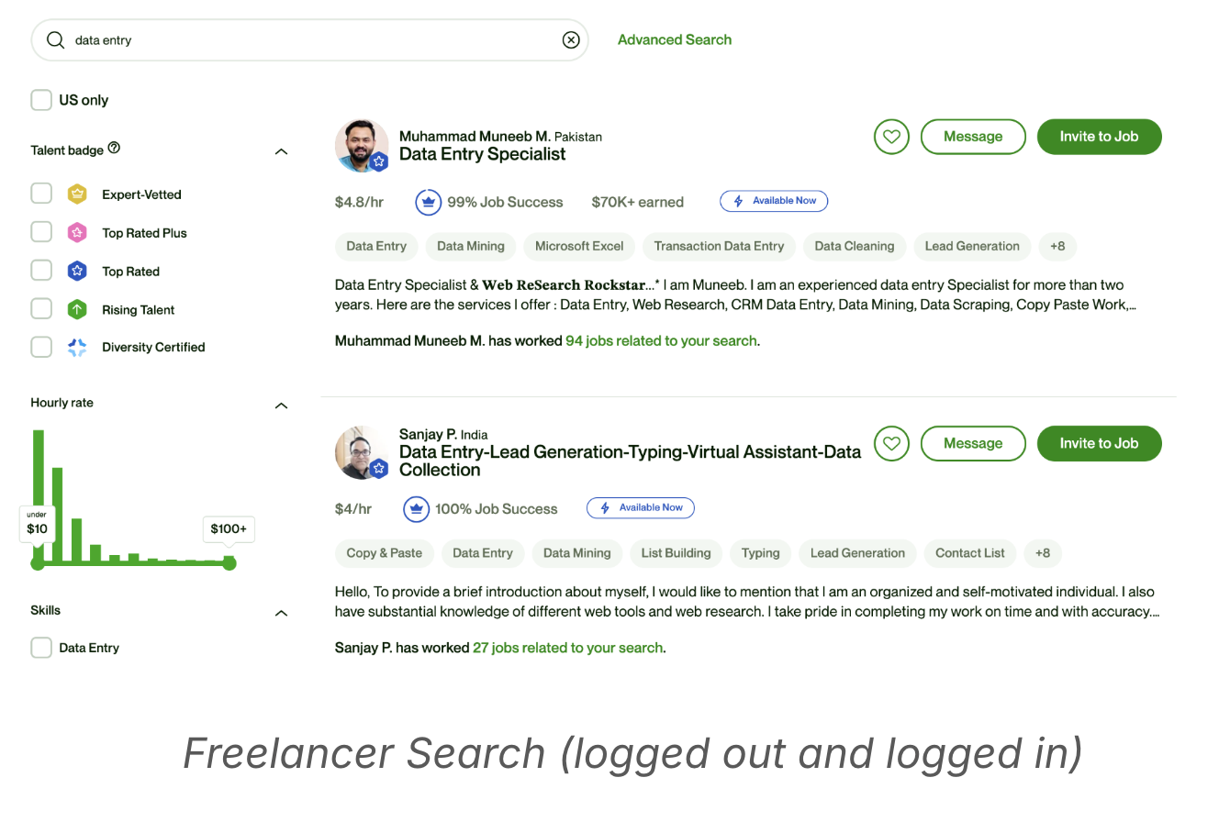
Product Surfaces - Clients Search Freelancers
Notes:
Relevance across UJS/UFS/FWH/PropMgr

Slide 6
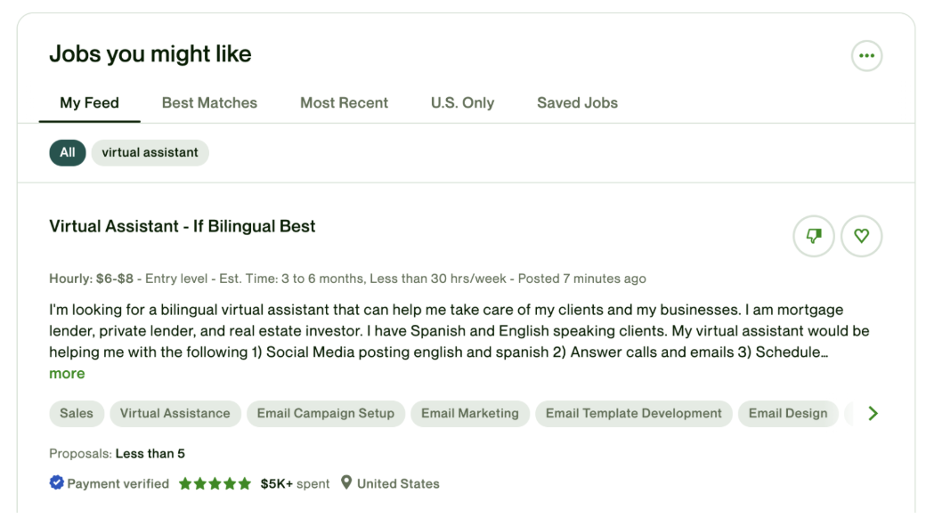
Product surface Freelancer Job Recommender
Find Work Home - Freelancer Home Page Job recommendations

Slide 7
Why Search & Recommendation Ranking Matters
Drive key business outcomes
Better ranking -> more relevant client-freelancer matching, higher conversion, and platform efficiency
Search is the gateway to discovery
- Upwork clients rely on search to find top talent
quickly
Recommendation fuels engagement
- Personalized feeds on Freelancer Home influence job views and proposal/bid activity
Build trust with customers
- Understand user intent
- Explain how ranking works to customers

Slide 8
More Challenges in Upwork S&R
Delayed and sparse conversions Hires are observed weeks/months after first engagement
Cannibalization among different S&R surfaces
Last-touch or All-touch attribution?
Objective function - Engagement vs. Conversion bid/invites -> hires -> total GSV
Two-sided selection Even after a “hire,” freelancers may decline without any penalty

Slide 9
Multi-task Learning and MOO architecture
MMOE
Task Hire Tower
Task Click Tower
Xgboost
…
Retrieval Results
~500
Leaf indices
MOO blending function
Expert Networks
Lexical+
Semantic Search
~5M
Feature Store
Shared Layers
Notes:
If you are considering whether to build discriminative vs. generative models, I would recommend to start with a discriminative deep learning model architecture. DCN, DIN, Sequence models, etc. Ads ranking

Slide 10
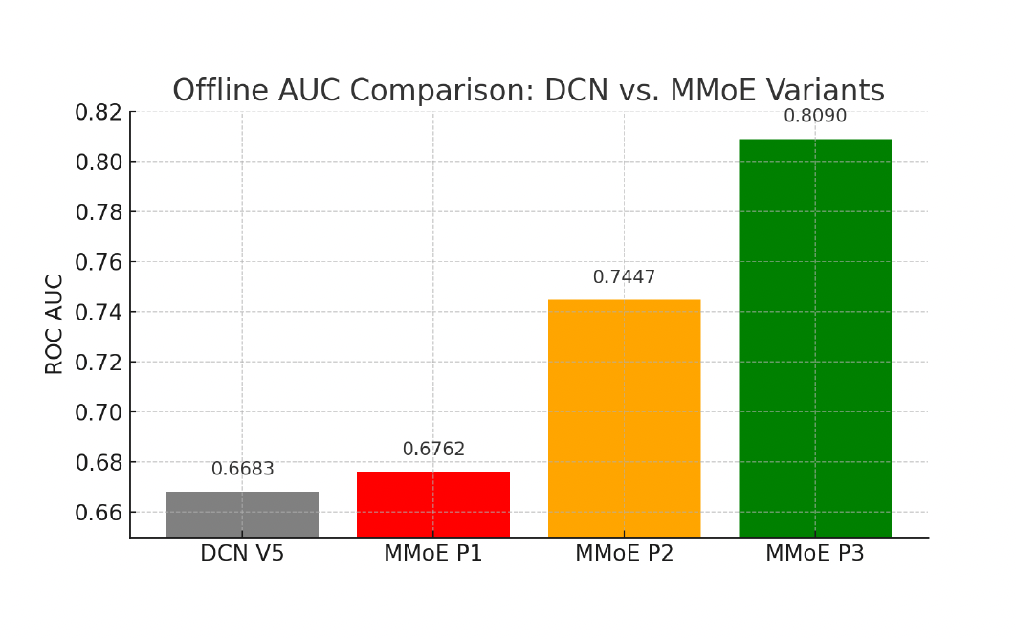
Multi-task Learning Improved Hires/GSV
P1 - hire only
P2 - P1 + click, invite, msg
P3 - P2 + direct_hire, direct_msg
A/B test +9% GSV improvement DCN V5 -> MMoE P3

Slide 11
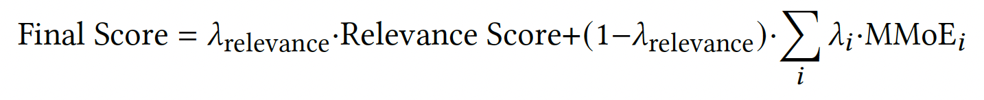
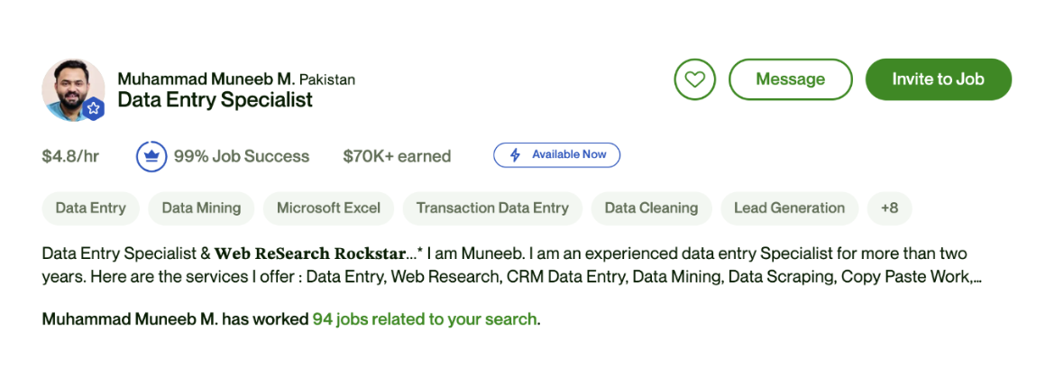
Perceived Relevance metrics improves MOO
By adding hourly rate, job success rate, earning, availability, and past experience into evaluating optimal weights, A/B successful rate was up 2-3X.

Slide 12
Advantages of LLM in S&R Systems
LLMs have the potential to enhance S&R in various aspects
Item semantics
User intention
Context understanding
Few-shot generalization
(New) interest Inference
Cross-domain generalization
Knowledge
Generalization
Personalized content generation
Generative Rec
…
Generation
Text understanding + world knowledge of LLMs → enhance item understanding and user modeling
Generalization abilities of LLMs → quickly adapt to (new) recommendation tasks and quickly infer user interests.
Generative abilities of LLMs → personalized content generation and generative Search+Rec
Notes:
Different routes available: 1. Leverage LLM / transformer as the underlying model architecture;
2. Direct use out-of-box LLM
3.

Slide 13
Challenges of Using LLMs Directly for S&R
Lack of domain specific knowledge
Designed for general tasks but not for recommendation-specific tasks.
Results in less accurate and non-personalized recommendations.
Difficulty in modeling personalized user behavior
Doesn’t handle user-item interaction data (clicks, purchases) well.
Misses out on capturing dynamic patterns of user preferences over time.

Slide 14
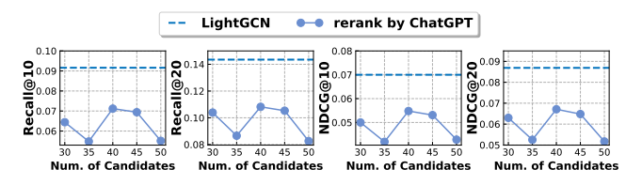
New Opportunities: LLM-based Recommendation
One example: LightGCN vs. ChatGPT for recommendation
LightGCN: a simple graph-based CF method
ChatGPT: directly leverage ChatGPT for recommendation
The much smaller LightGCN delivers more effective recommendations than ChatGPT
Wee need to enhance LLM-based recommendation
Ren, et. al. Representation Learning with Large Language Models for Recommendation. WWW 2024.

Slide 15
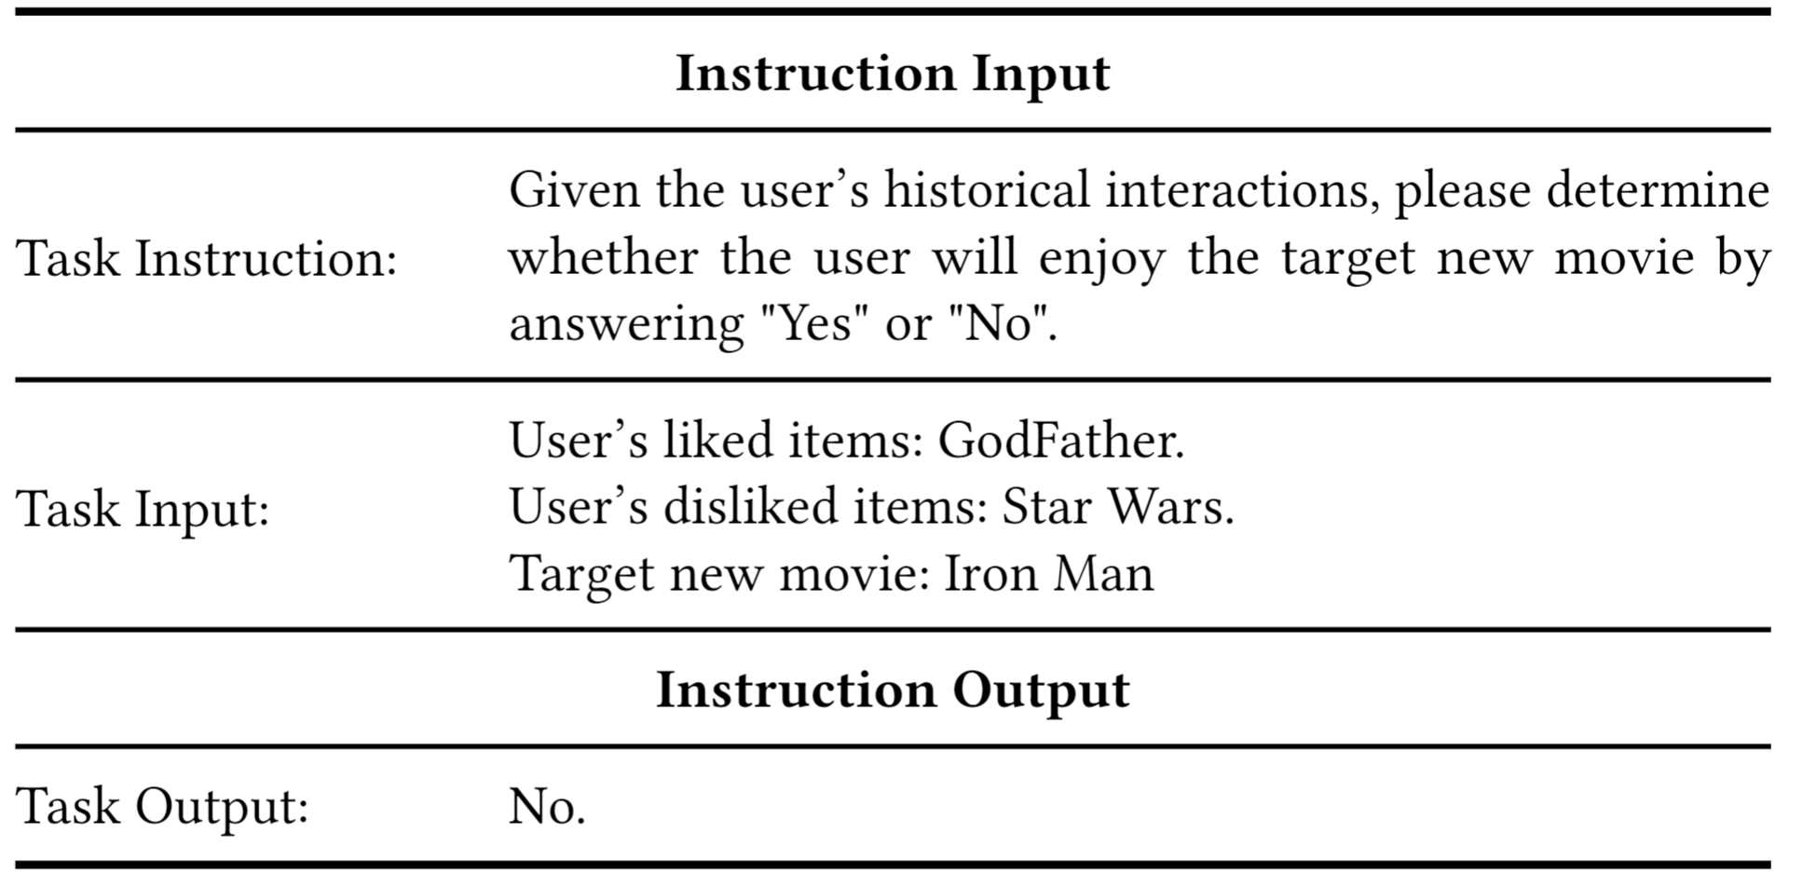
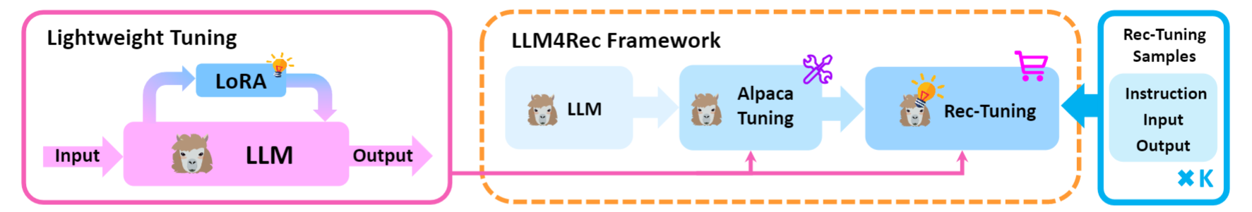
LLM Post Training for Recommendation
Objective: Equip the LLM with the necessary knowledge and task-specific format to understand user preferences and item characteristics in recommendations.
Supervised Fine-Tuning: TALLRec[1], BIGRec[2]
Limitations: Ignore the Preference Order
Highlight the Need for Preference Alignment
[1] Keqin Bao et al. TALLRec: An Effective and Efficient Tuning Framework to Align Large Language Model with Recommendation. In Recsys 2023.
[2] Keqin Bao et al. A Bi-Step Grounding Paradigm for Large Language Models in Recommendation Systems. In ACM TORS.
Notes:
The objective of post-training is to adapt Large Language Models (LLMs) to understand recommendation tasks. A direct approach is Supervised Fine-Tuning (SFT). Our representative works like TALLRec and BIGRec describe the recommendation task in natural language and use instruction-tuning with recommendation-specific data to effectively and effciently teach an LLM to understand the task.
Nevertheless, this approach only models point-wise relevance—scoring items in isolation—and ignores the crucial preference ordering between candidates. This highlights the need for a paradigm focused on
Order-based Preference Alignment, which learns from the relative choice of "which is better."

Slide 16
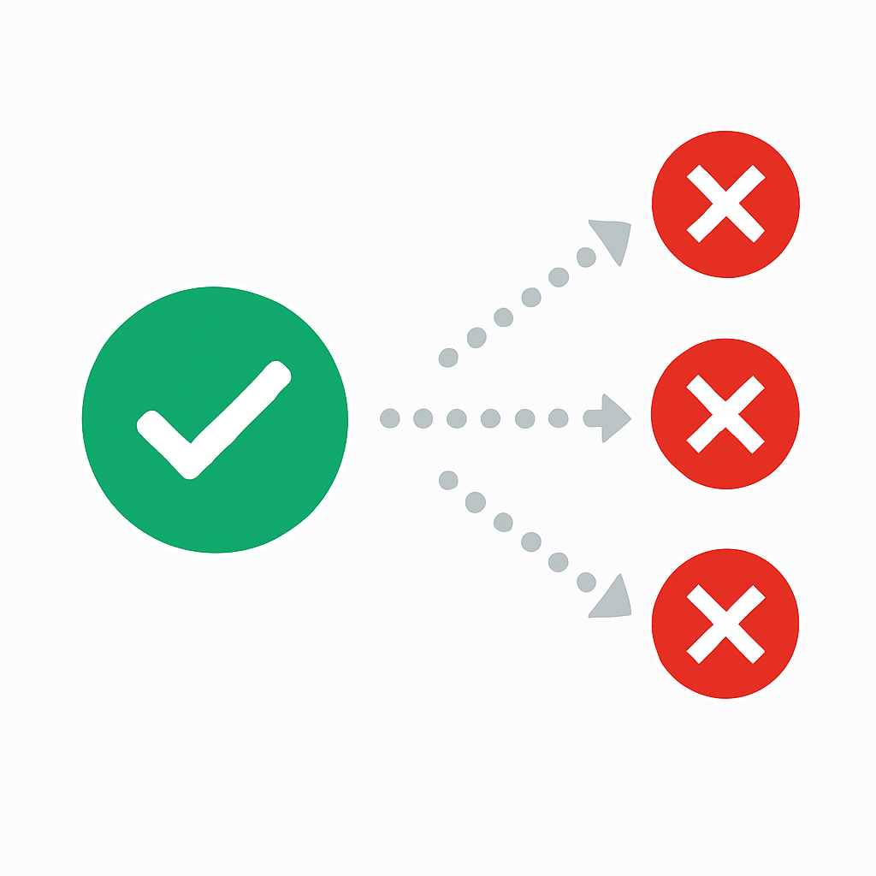

Preference Alignment
Objective: To train the LLMs to rank candidates by learning the ordinal relationships in user preference data.
Key Challenges:
Sample Quality:
Effective training requires mining hard negatives, as most random samples offer trivial learning value.
Multiple Negative Preference:
In real-world, a preferred item is often superior not just to one alternative, but to a whole set of competitive candidates simultaneously.
Notes:
The objective of Preference Alignment is to train LLMs to rank candidates by learning the ordinal relationships in user preference data.
To achieve this effectively, two key challenges must be addressed:
1. Sample Quality. Effective training requires mining for 'hard' negatives, as most random samples offer only trivial learning value.
2. Multiple Negative Preference. Real-world choice involves selecting a single preferred item from a competitive slate. Standard alignment methods, such as Direct Preference Optimization (DPO), simplify this to a pairwise comparison (is A better than B?), which fails to capture the complexity of ranking one item over a whole set of alternatives simultaneously.

Slide 17
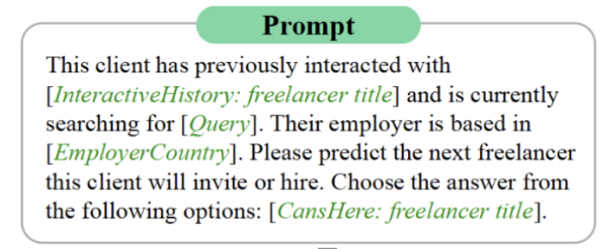
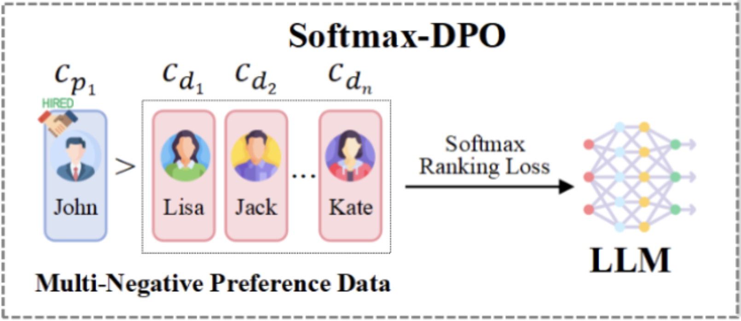
Our Approach: Softmax-DPO for Preference Alignment
Encode query, clients, jobs, and talent features into the prompt.
Calculate probability distribution over the entire candidates.
Use DPO loss function to reward the positive candidate over
negative ones.
Notes:
To solve the challenges of sample quality and preference structure, we propose the Softmax-DPO framework.
Our framework operates through three distinct stages, as illustrated in the diagram.
First is Query Processing, where we encode the user's precise intent.
Second, in Candidate Representation, we encode rich profiles for each candidate, combining textual data with numeric features like Job Success Score and historical interactions.
Third is the Scoring Mechanism, where a Softmax Layer calculates a probability distribution over the entire slate of candidates.
Finally, the fourth stage is Softmax Optimization, where our DPO loss function uses these probabilities to update the model, rewarding it for correctly ranking the positive candidate highest.
Specifically, it solves the two challenges as follows:
To address Sample Quality, we use Quality-Aware Learning. Our Candidate Representation is enriched with quality signals like JSS and user history. Our weighted loss mechanism then uses this information to focus learning on the most informative examples.
To handle Multiple Negative Preferences, we employ Multi-Negative Optimization. Our Softmax Ranking Loss directly models the one-versus-many scenario, allowing the model to rank a single positive against an entire slate of negatives simultaneously.

Slide 18
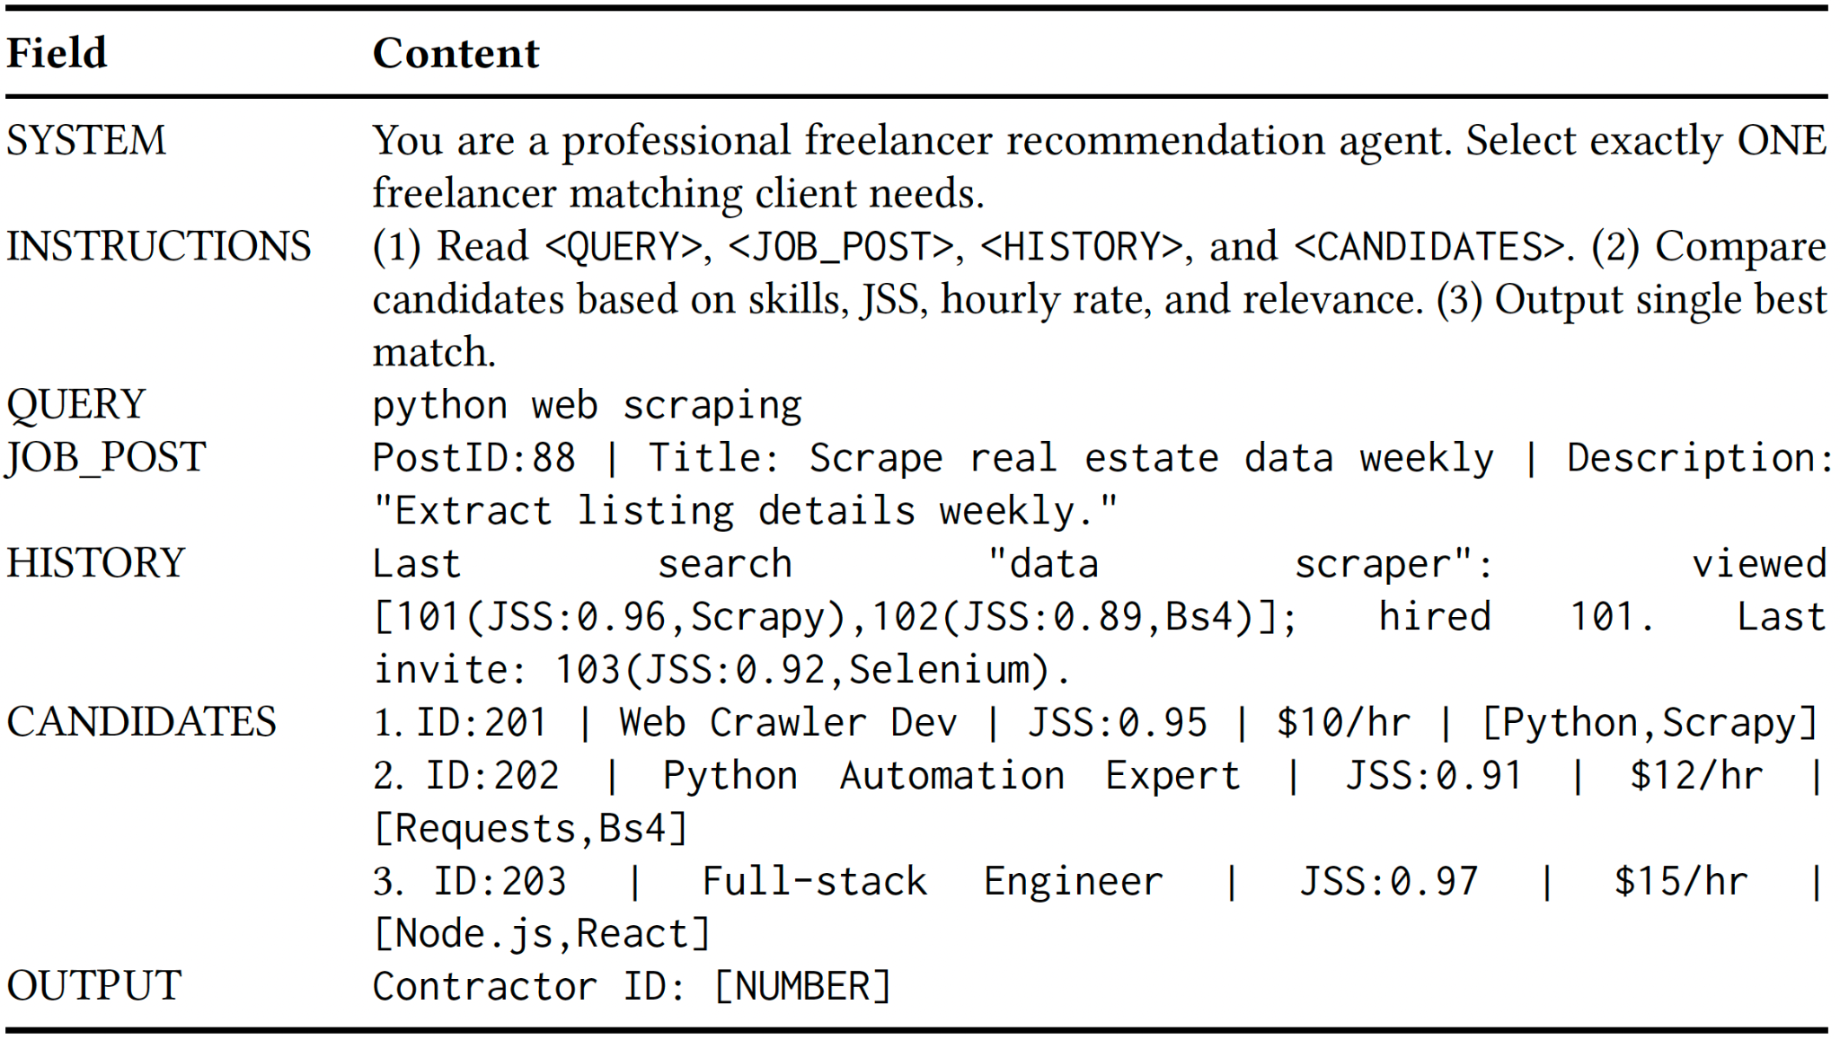
Example Prompt Format (Inference Input)
Notes:
We validated our method on over 62,000 real-world preference pairs.
This chart compares Softmax-DPO against baselines like BM25, RankNet, and standard DPO across three metrics: Precision@1 , NDCG@5 , and MRR@5.
The results show our Softmax-DPO model consistently and significantly outperformed all other methods across all key metrics. This provides empirical validation for our approach.

Slide 19
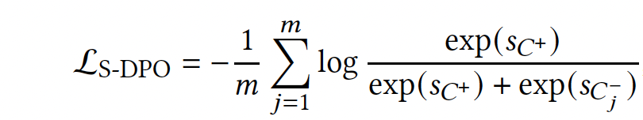
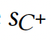
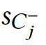
S-DPO (Multi-negative Sampling) Preference Alignment
S-DPO (Multi-negative Sampling): Include hard-negatives (impressed but no hired) and soft-negatives (random samples and in-batch negatives)
Where and represent the relevance scores calculated for positive and negative j, respectively.
Notes:
To solve the challenges of sample quality and preference structure, we propose the Softmax-DPO framework.
Our framework operates through three distinct stages, as illustrated in the diagram.
First is Query Processing, where we encode the user's precise intent.
Second, in Candidate Representation, we encode rich profiles for each candidate, combining textual data with numeric features like Job Success Score and historical interactions.
Third is the Scoring Mechanism, where a Softmax Layer calculates a probability distribution over the entire slate of candidates.
Finally, the fourth stage is Softmax Optimization, where our DPO loss function uses these probabilities to update the model, rewarding it for correctly ranking the positive candidate highest.
Specifically, it solves the two challenges as follows:
To address Sample Quality, we use Quality-Aware Learning. Our Candidate Representation is enriched with quality signals like JSS and user history. Our weighted loss mechanism then uses this information to focus learning on the most informative examples.
To handle Multiple Negative Preferences, we employ Multi-Negative Optimization. Our Softmax Ranking Loss directly models the one-versus-many scenario, allowing the model to rank a single positive against an entire slate of negatives simultaneously.

Slide 20
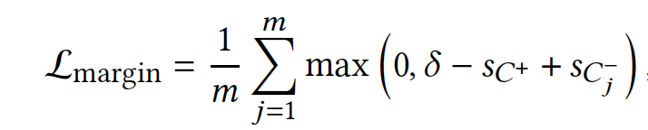
Margin-aware Preference Alignment
Margin-aware: Separates preferred from rejected candidates more clearly and significantly enhances the discriminative power of the model
Where the hyperparameter 𝛿 explicitly specifies the desired minimum score separation
Notes:
To solve the challenges of sample quality and preference structure, we propose the Softmax-DPO framework.
Our framework operates through three distinct stages, as illustrated in the diagram.
First is Query Processing, where we encode the user's precise intent.
Second, in Candidate Representation, we encode rich profiles for each candidate, combining textual data with numeric features like Job Success Score and historical interactions.
Third is the Scoring Mechanism, where a Softmax Layer calculates a probability distribution over the entire slate of candidates.
Finally, the fourth stage is Softmax Optimization, where our DPO loss function uses these probabilities to update the model, rewarding it for correctly ranking the positive candidate highest.
Specifically, it solves the two challenges as follows:
To address Sample Quality, we use Quality-Aware Learning. Our Candidate Representation is enriched with quality signals like JSS and user history. Our weighted loss mechanism then uses this information to focus learning on the most informative examples.
To handle Multiple Negative Preferences, we employ Multi-Negative Optimization. Our Softmax Ranking Loss directly models the one-versus-many scenario, allowing the model to rank a single positive against an entire slate of negatives simultaneously.

Slide 21
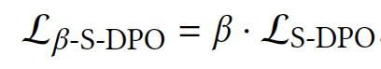
β-DPO (Adaptive Calibration) Preference Alignment
β-DPO (Adaptive Calibration): apply weights to dynamically adjust the contribution of each training instance, e.g., GSV-weighted or user-segment weighted.
Finally, the total loss function is
where 𝜆 is a hyperparameter of the relative importance of the margin-aware loss
Notes:
To solve the challenges of sample quality and preference structure, we propose the Softmax-DPO framework.
Our framework operates through three distinct stages, as illustrated in the diagram.
First is Query Processing, where we encode the user's precise intent.
Second, in Candidate Representation, we encode rich profiles for each candidate, combining textual data with numeric features like Job Success Score and historical interactions.
Third is the Scoring Mechanism, where a Softmax Layer calculates a probability distribution over the entire slate of candidates.
Finally, the fourth stage is Softmax Optimization, where our DPO loss function uses these probabilities to update the model, rewarding it for correctly ranking the positive candidate highest.
Specifically, it solves the two challenges as follows:
To address Sample Quality, we use Quality-Aware Learning. Our Candidate Representation is enriched with quality signals like JSS and user history. Our weighted loss mechanism then uses this information to focus learning on the most informative examples.
To handle Multiple Negative Preferences, we employ Multi-Negative Optimization. Our Softmax Ranking Loss directly models the one-versus-many scenario, allowing the model to rank a single positive against an entire slate of negatives simultaneously.

Slide 22
Indigo-DPO Training process
Stage 1 - Supervised fine tuning (SFT) only leverages hires as positive.
Stage 2 - Perform S-DPO Multi-negative, Margin-aware, and β-DPO.
Use LoRA-adapted LLaMA-7B (approximately 20M trainable parameters) trained on 8×A100 GPUs.
Notes:
We validated our method on over 62,000 real-world preference pairs.
This chart compares Softmax-DPO against baselines like BM25, RankNet, and standard DPO across three metrics: Precision@1 , NDCG@5 , and MRR@5.
The results show our Softmax-DPO model consistently and significantly outperformed all other methods across all key metrics. This provides empirical validation for our approach.

Slide 23
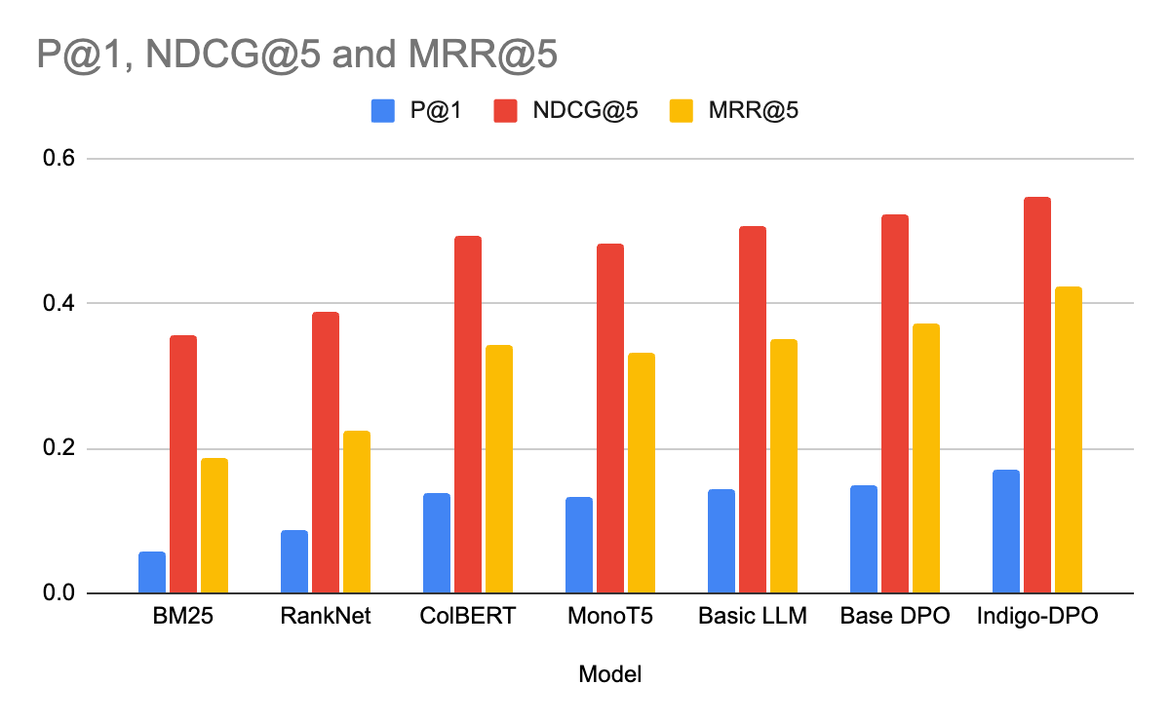
Experimental Results
Our Softmax-DPO consistently outperformed all other models across all key metrics.
Notes:
We validated our method on over 62,000 real-world preference pairs.
This chart compares Softmax-DPO against baselines like BM25, RankNet, and standard DPO across three metrics: Precision@1 , NDCG@5 , and MRR@5.
The results show our Softmax-DPO model consistently and significantly outperformed all other methods across all key metrics. This provides empirical validation for our approach.

Slide 24
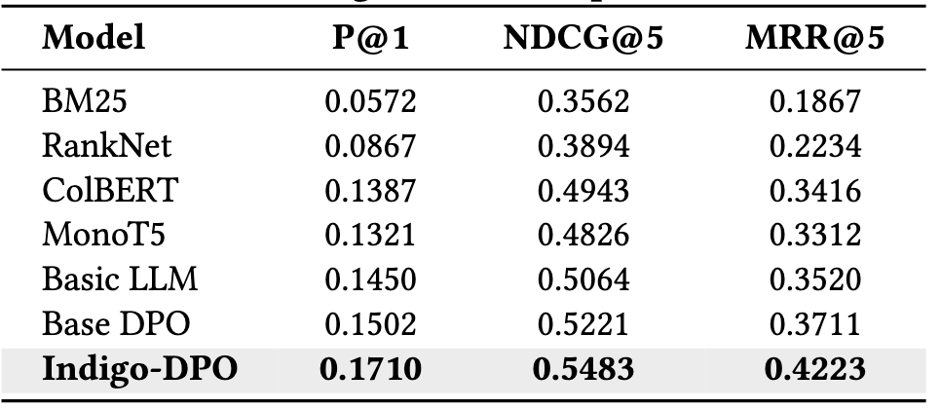
Quantitative Results on Upwork Search Evaluation
Indigo-DPO achieves the best results across all ranking metrics on the Upwork test set.
- Compared with the strongest baseline (Base DPO):
• +13.85% improvement in Precision@1
• +4.94% improvement in NDCG@5
• +13.80% improvement in MRR@5
– Compared with the MMOE production model
• +1.5% improvement in Precision@1
Key Insight:
- Substantial Precision@1 gain confirms Indigo-DPO's effectiveness in surfacing the most relevant candidate.
- Especially important in high-stakes Upwork hiring scenarios, where clients often engage with the top result only.
Notes:
We validated our method on over 62,000 real-world preference pairs.
This chart compares Softmax-DPO against baselines like BM25, RankNet, and standard DPO across three metrics: Precision@1 , NDCG@5 , and MRR@5.
The results show our Softmax-DPO model consistently and significantly outperformed all other methods across all key metrics. This provides empirical validation for our approach.

Slide 25
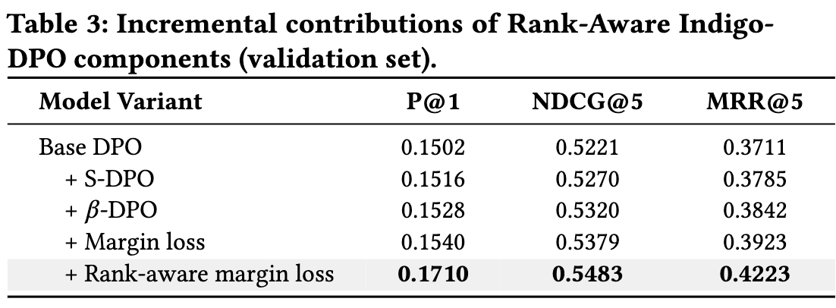
Component-Level Contributions of Indigo-DPO
- We evaluate the incremental impact of each module
🔹 + S-DPO (Multi-negative Sampling):
• Adds diversity in training and stabilizes optimization
• Slight boost in P@1 and ranking robustness
🔹 + β-DPO (Adaptive Calibration):
• Reweights multilingual or noisy samples
• Improves consistency across global freelancer profiles
🔹 + Margin Loss:
• Separates preferred from rejected candidates more
• Helps the model rank by stronger preference signals
🔹 + Rank-Aware Margin Loss:
• Final boost in top-1 and ranking quality
Notes:
We validated our method on over 62,000 real-world preference pairs.
This chart compares Softmax-DPO against baselines like BM25, RankNet, and standard DPO across three metrics: Precision@1 , NDCG@5 , and MRR@5.
The results show our Softmax-DPO model consistently and significantly outperformed all other methods across all key metrics. This provides empirical validation for our approach.

Slide 26
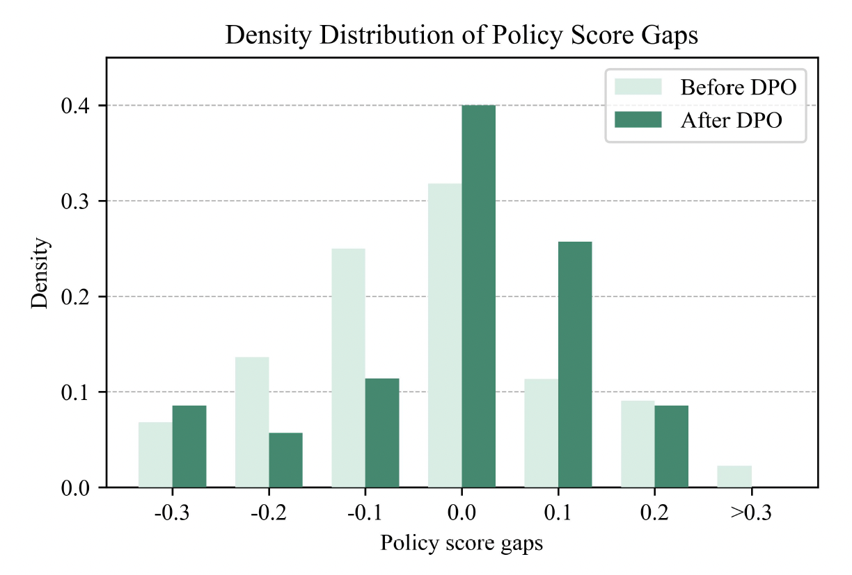
Margin Improvement Analysis
Policy score gap = 𝑠 (𝑐+) −𝑠 (𝑐−)
36.4% drop of score gap and stronger separation between + and -’s

Slide 27
Case Study: Python Scraping Query on Upwork
Real Query: "python web scraping"
- Client searched for freelancers with scraping experience.
Candidate Comparison:
- Baselines (BM25, MonoT5):
• Ranked a highly-rated but generalist developer at the top
- Indigo-DPO:
• Ranked a modest but Scrapy-focused freelancer as top-1
• Captured better alignment with client’s actual intent
• Factored in prior hires for similar job types
Outcome:
- Indigo-DPO’s top-1 candidate was hired in this real session
- Shows ability to go beyond surface relevance and match client preferences
Notes:
We validated our method on over 62,000 real-world preference pairs.
This chart compares Softmax-DPO against baselines like BM25, RankNet, and standard DPO across three metrics: Precision@1 , NDCG@5 , and MRR@5.
The results show our Softmax-DPO model consistently and significantly outperformed all other methods across all key metrics. This provides empirical validation for our approach.

Slide 28
Future work
Serve the Indigo-DPO in production Offline batch serving showed ~60ms P99 latency with T4 GPUs
Provide explanation and insights in S&R results
AI summaries and insights win customer trust and confidence
Dual-alignment between Semantic-ID and DPO ranking DPO optimizes token-IDs based on downstream recommendation performance

Slide 29
We are Hiring!
Multiple open roles on S&R, LLM, Agents
https://www.upwork.com/careers/

Slide 30
Thank you!

